Slide 1
Naïve Bayes
Rose Sloan
rsloan@bard.edu

Slide 2
Midterm
Midterm on Wednesday, March 13
In class closed book pen and paper exam
Will cover any content discussed in class this week or earlier
You may bring a calculator (though no problems should require a calculator)
You may bring a single page “cheat sheet”
Bring questions to class on Monday!

Slide 3
Recall: Bayes Theorem
We can figure out the probability of an unobservable event B given some observable event A, if we know the prior probability of B, the probability of A given B, and the probability that A occurs at all
E.g. if we flip a coin and land on heads, we can compute the probability that our coin is fair

Slide 4
Conditional Probability and ML
Recall tennis example: predict whether I play tennis given certain whether conditions
E.g. If it is sunny, hot, humid, and windy, will I play tennis?
Probabilistic interpretation: given that it is sunny, hot, humid, and windy, what is the probability I play tennis?
Is P(playTennis | sunny, hot, humid, windy) greater than P(don’tPlayTennis | sunny, hot, humid, windy)?
For binary classification, we can just check if the probability that we play tennis is above 50%

Slide 5
Naïve Bayes
Concept: return the class label with the highest conditional probability given the input features
Formally: given input features x₀, x₁, …, x_{n} and possible class labels C₀, C₁, …, C_{m}, return the class C_{k} that maximizes P(C_{k}| x₀, x₁, …, x_{n} )
Assume that all features are conditionally independent on all class labels
Formally: for any i, j, k with i≠j, P(x_{i},x_{j}|C_{k}) = P(x_{i}|C_{k})P(x_{j}|C_{k})
Note that this an assumption that is usually not actually true!

Slide 6
Finding the Probability
For each class C_{k}, we must find P(C_{k} | x₁, x_{2,} …, x_{n})
By the definition of conditional probability:
Because the features are all conditionally independent:

Slide 7
Interpreting This Formula
We have shown that:
By Bayes’ Law:
This indicates that:

Slide 8
Computing the Probabilities
For now, we will assume that we have no continuous features
To compute P(C_{k} | x), we now just need to compute P(C_{k}), P(x) and P(x_{i} | C_{k})
Recall that we are simply trying to find the class C_{k} that maximizes P(C_{k} | x)
Since P(x) remains the same across different classes, iff P(C_{k} | x) is greater than P(C_{j} | x), P(x | C_{k})P(C_{k}) is greater than P(x | C_{j})P(C_{j})
Therefore, for now we will ignore the P(x) term

Slide 9
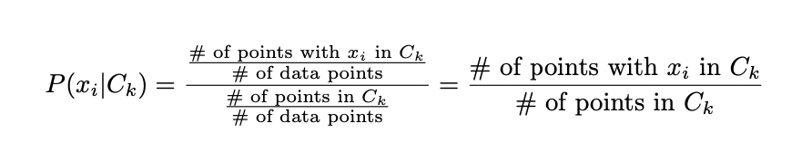
Computing the Probabilities
The prior P(C_{k}) is simply the fraction of training data points that belong to class C_{k}
Similarly, P(x_{i}, C_{k}) is the fraction of training data points in class C_{k} that have feature x_{i}
Then

Slide 10
Example: Playing Tennis
Day | Weather | Temperature | Humidity | Wind | Play Tennis?
1 | Sunny | Hot | High | Weak | No
2 | Sunny | Hot | High | Strong | No
3 | Overcast | Hot | High | Weak | Yes
4 | Rain | Mild | High | Weak | Yes
5 | Rain | Cool | Normal | Weak | Yes
6 | Rain | Cool | Normal | Strong | No
7 | Overcast | Cool | Normal | Strong | Yes
8 | Sunny | Mild | High | Weak | No
9 | Sunny | Cool | Normal | Weak | Yes
10 | Rain | Mild | Normal | Weak | Yes
11 | Sunny | Mild | Normal | Strong | Yes
12 | Overcast | Mild | High | Strong | Yes
13 | Overcast | Hot | Normal | Weak | Yes
14 | Rain | Mild | High | Strong | No

Slide 11
Example: Playing Tennis
Let us try to classify a day that is sunny, hot, humid, and windy
There are two classes: Yes and No
In the data, we have priors: P(Yes) = 9/14 and P(No) = 5/14
Training data has 2 sunny days in Yes and 3 sunny days in No
P(sunny | Yes) = 2/9, P(sunny | No) = 3/5
Training data has 2 hot days in Yes, 2 in No
P(hot| Yes) = 2/9, P(hot| No) = 2/5
Training data has 3 humid days in Yes, 4 humid days in No
P(humid| Yes) = 3/9, P(humid| No) = 4/5
Training data has 3 windy days in Yes, 3 windy days in No
P(windy| Yes) = 3/9, P(hot| No) = 3/5
Notes:
Note: we do not “expand” categorical features here because, e.g., P(sunny) and P(rain) are clearly not conditionally independent!

Slide 12
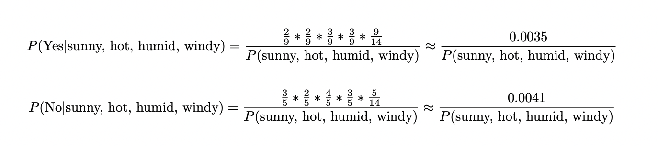
Example: Playing Tennis
Using the probabilities we just found:
Since P(sunny, hot, humid, windy) remains the same, we can say that P(No|sunny, hot, humid, windy) is higher and predict No

Slide 13
Finding P(x)
In some cases, we may wish to actually know the probability P(C_{k}|x)
To do this, we must calculate P(x)
Features x_{i} and x_{j} are not independent (just conditionally independent), so we cannot just multiply their probabilities
E.g. P(sunny, hot, humid, windy) ≠ P(sunny)P(hot)P(humid)P(windy)
But x must belong to some class C_{k} and we can calculate P(x|C_{k})—sum over all possible classes
E.g. P(sunny, hot, humid, windy) = P(sunny, hot, humid, windy, Yes) + P(sunny, hot, humid, windy, No)
Notes:
Recall that two features x_i and x_j are not necessarily independent, just conditionally independent, so we cannot just say P(sunny, windy) = P(sunny)P(windy)

Slide 14
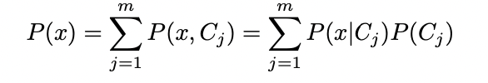
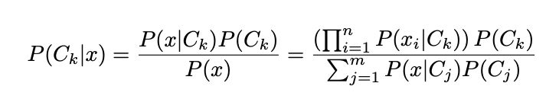
Finalizing our Definition
In a general case, let us assume we have m classes C₀, C₁, …, C_{m}
Then:
And:

Slide 15
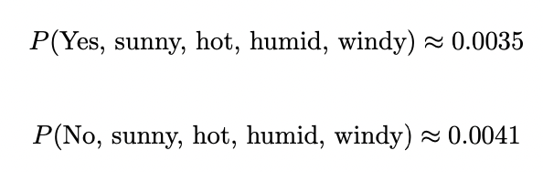
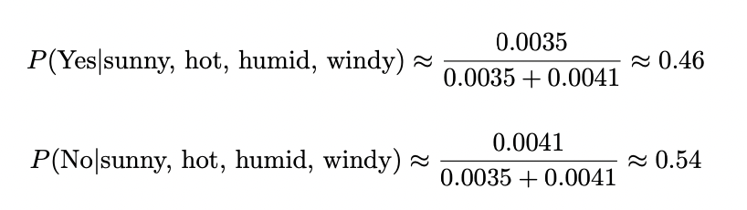
Tennis Example
We showed previously:
Then:

Slide 16
Document Classification
Naïve Bayes is commonly used to solve a broad set of problems known as document classification or text classification
Basic idea: Given some string of natural language text, classify it in some way
Examples:
Sort emails into spam and non-spam
Sort newspaper articles by broad topic
Sort reviews into positive or negative categories
Common approach: use a bag of words model, look only at what words appear in the document, not their order

Slide 17
A Simple Approach
Treat document as bag of words where each word’s probability is conditionally independent on all other words
E.g. P(“Loved this movie” | positive) = P(“loved”|positive)P(“this”|positive)P(“movie”|positive)
Simple approach to P(word|C_{k})—find the fraction of documents of class C_{k} that contain the word
What are the problems with this approach?

Slide 18
Bag of Words
Still want to look at how many times any given word appears, not just whether it appears
Example: A movie review that says “loved” 10 times might be more likely to be positive than one that says “loved” once
Concept: P(w | C_{k}) is the probability that any given word in a document of class C_{k} is w
Then, by independence assumptions:
P(“Loved loved loved it”|positive) = P(“loved”|positive)³P(“it”|positive)

Slide 19
Multinomial Naïve Bayes
A multinomial distribution is a distribution generated by rolling a weighted k-sided die
In our current approach, treat each class as a weighted die where the sides are different words in our vocabulary
Note that while this works pretty well for classification, it’s pretty bad for producing text
E.g. If the positive movie reviews as a group contain 100 words, two of which are “loved”, P(“loved”|positive) = 0.02

Slide 20
Example: Movie Reviews
Training
“Good cheesy fun” – positive
“Really entertaining movie” – positive
”Surprisingly good movie” – positive
“Watch a good movie instead” – negative
“Not fun or worth your time” – negative
Test
“Good fun movie”

Slide 21
Example: Movie Reviews
We need to find P(positive | “Good fun movie”) and P(negative | “Good fun movie”)
We have 3 positive reviews and 2 negative reviews
P(positive) = 3/5, P(negative) = 2/5
We have 9 words in our positive reviews and 11 in negative reviews

Slide 22
Example: Movie Reviews
“Good” appears twice in positive reviews, once in negative reviews
P(“good” | positive) = 2/9, P(“good” | negative) = 1/11
“Fun” appears once in each class
P(“fun” | positive) = 1/9, P(“fun” | negative) = 1/11
“Movie” appears twice in positive reviews, once in negative reviews
P(“movie” | positive) = 2/9, P(“movie” | negative) = 1/11

Slide 23
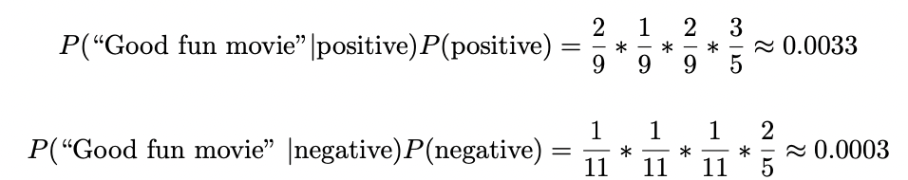
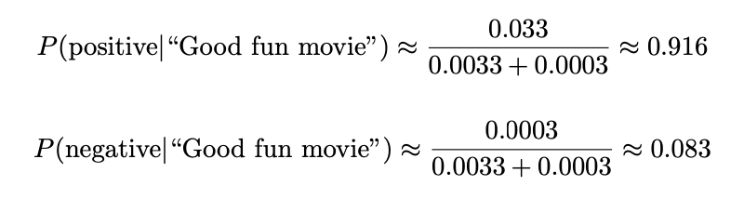
Example: Movie Reviews
Using the probabilities from the last slide:
Then, normalizing out:
So (per our model) there is a 91.6% chance this review is positive!

Slide 24
Missing Values
One problem: what happens if a word in our test set doesn’t appear anywhere in our training set?
Even with a large training set, this is pretty likely to happen
Natural languages usually have hundreds of thousands of words
New words are coined frequently
Some documents (such as spam emails or online reviews) are fairly likely to contain typos
What happens if we come across a document with a new word?
Or what if a word only appears in one class in the training set?
Notes:
Estimates for number of words in the English language range from 170,000 to a million

Slide 25
Motivation for Smoothing
If the word w never appears in our training data in class C_{k}, then P(w|C_{k}) is 0
Then, if document x contains w, P(C_{k}|x) must be 0 (regardless of anything else about x!)
As a principle, we don’t want to assume something is impossible just because it doesn’t show up in our training data
Concept: Adjust probabilities so that every word has a nonzero (though possibly very small) of appearing in every class

Slide 26
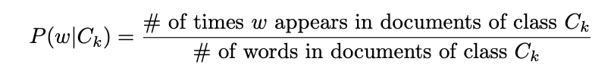
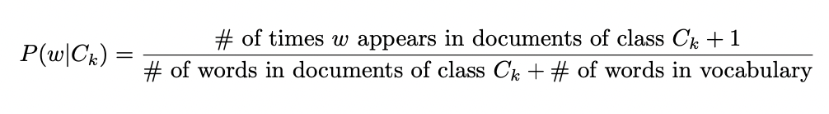
LaPlace Smoothing
So far, we have assumed that
To smooth, assume that there is one “extra” occurrence of each word in vocabulary (i.e. start counting at 1, not 0)
Vocabulary size is generally determined during preprocessing
Then:
Notes:
Also called add one smoothing
LaPlace smoothing is the simplest way to do smoothing, but there are other (often better) approaches

Slide 27
Example: Movie Reviews
Training
“Good cheesy fun” – positive
“Really entertaining movie” – positive
”Surprisingly good movie” – positive
“Watch a good movie instead” – negative
“Not fun or worth your time” – negative
Test
“Good fun movie”

Slide 28
Movie Example With Smoothing
Our vocabulary in this example contains 15 unique words
We still have 9 words in our positive reviews and 11 in our negative reviews
“Good” appears twice in positive reviews, once in negative reviews
P(“good” | positive) = 3/24, P(“good” | negative) = 2/26
“Fun” appears once in each class
P(“fun” | positive) = 2/24, P(“fun” | negative) = 2/26
“Movie” appears twice in positive reviews, once in negative reviews
P(“movie” | positive) = 3/24, P(“movie” | negative) = 2/26

Slide 29
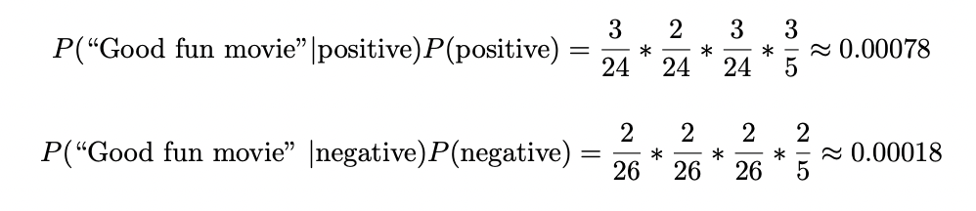
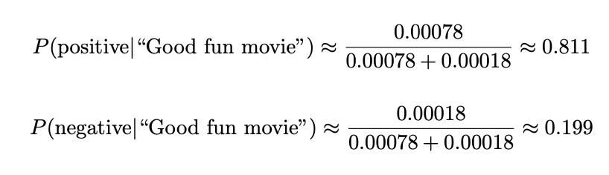
Movie Example With Smoothing
Using the probabilities from the last slide:
Then, normalizing out:
Now there is a 81.1% chance this review is positive!

Slide 30
Naïve Bayes Conclusions
Naïve Bayes is a classification method built around using Bayesian probability to figure out the probability of a class label given a certain set of features
Naïve Bayes is based on the assumption that features are conditionally independent of each other
This is usually not true, but it’s “close enough”
Naïve Bayes is often a strong approach for text classification
Smoothing is important to avoid zero probabilities

